Slide 1
SQL Practice 1 One table, Aggregation, Group By 24 Queries
Database: DBSQLPractice.sql

Slide 2
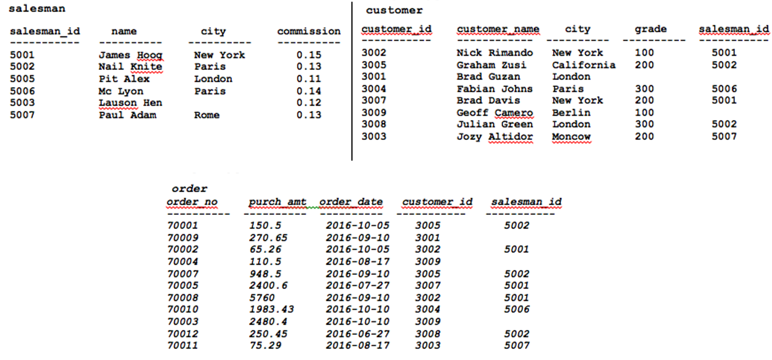

Slide 3
Display name and commission for all the salesmen.
Retrieve salesman id of all salesmen from orders table without any repeats.
Display names and city of salesman, who belongs to the city of Paris.
Display all the information for those customers with a grade of 200.
Display the order number, order date and the purchase amount for order(s) which will be delivered by the salesman with ID 5001.
Show the winner of the 1971 prize for Literature.
Show all the details of the winners with first name Louis.
Show all the winners in Physics for 1970 together with the winner of Economics for 1971.
Show all the winners of Nobel prize in the year 1970 except the subject Physiology and Economics.
Find all the details of the Nobel winners for the subject not started with the letter 'P' and arranged the list as the most recent comes first, then by name in order.
Find the name and price of the cheapest item(s).
salesman (salesman_id, name, city, commission)
orders(ord_no, purch_amt, ord_date, customer_id, salesman_id)
customer(customer_id, cust_name, city, grade, salesman_id)
------------------------------------------------------------------------------
nobel_win(year, subject, winner, country, category)
item_mast(pro_id, pro_name, pro_price, pro_com)

Slide 4
Query 12
Display all the customers, who are either belongs to the city New York or not had a grade above 100.
customer(customer_id, cust_name, city, grade, salesman_id)
customer_id cust_name city grade salesman_id
3002 Nick Rimando New York 100 5001
3007 Brad Davis New York 200 5001
3009 Geoff Cameron Berlin 100 5003
SELECT *
FROM customer
WHERE city = 'New York' OR NOT grade > 100;

Slide 5
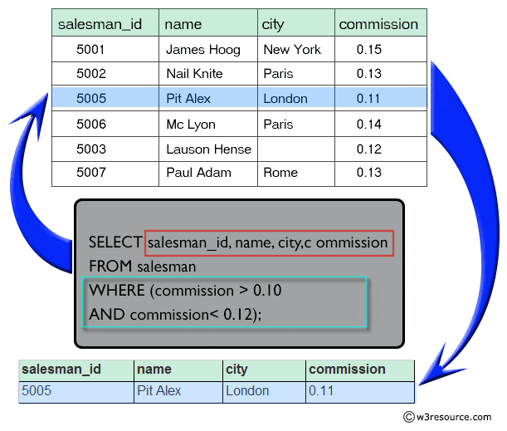
Query 13
Find those salesmen with all information who gets the commission within a range of 0.10 and 0.12.
salesman(salesman_id, name, city, commission)
SELECT salesman_id, name, city, commission
FROM salesman
WHERE (commission > 0.10 AND commission < 0.12);
SELECT salesman_id, name, city, commission
FROM salesman
WHERE commission between 0.10 AND 0.12;

Slide 6
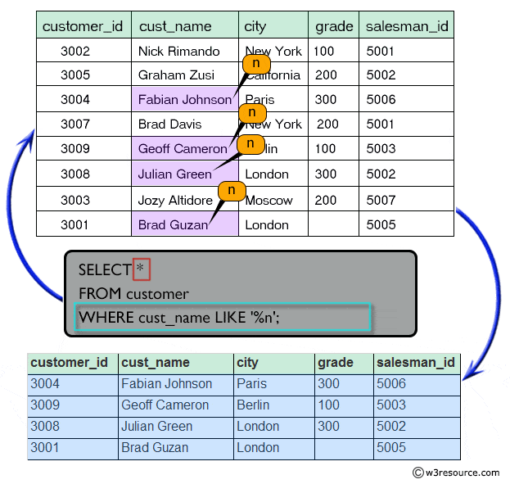
Query 14
Find all those customers with all information whose names are ending with the letter 'n'.
customer(customer_id, cust_name, city, grade, salesman_id)
SELECT *
FROM customer
WHERE cust_name LIKE '%n';

Slide 7
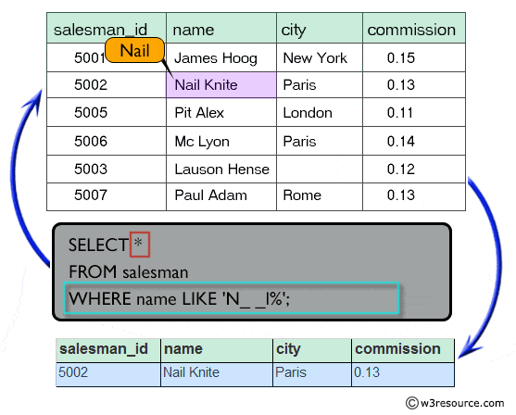
Query 15
Find those salesmen with all information whose name containing the 1st character is 'N' and the 4th character is 'l' and rests may be any character.
salesman(salesman_id, name, city, commission)
SELECT *
FROM salesman
WHERE name LIKE ‘N__l%';

Slide 8
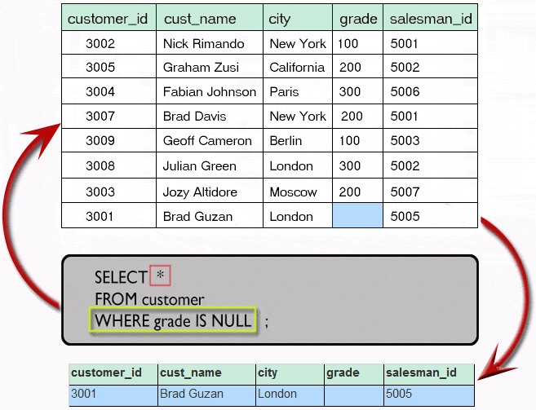
Query 16
Find that customer with all information who does not get any grade except NULL.
customer(customer_id, cust_name, city, grade, salesman_id)
SELECT *
FROM customer
WHERE grade IS NULL;

Slide 9
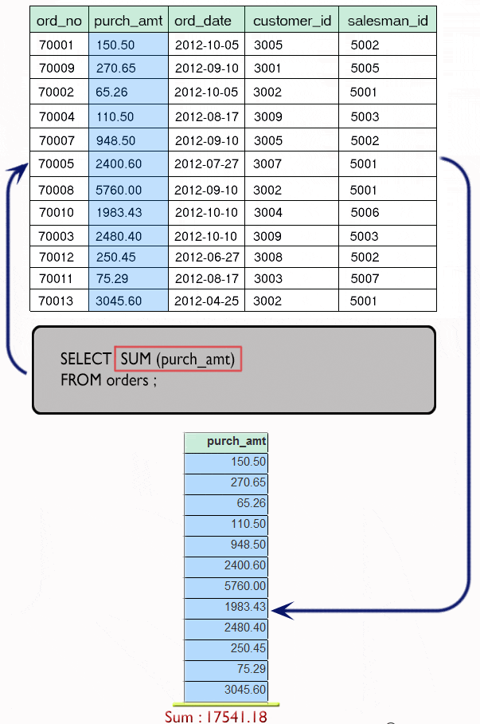
Query 17
Find the total purchase amount of all orders.
orders(ord_no, purch_amt, ord_date, customer_id, salesman_id )
SELECT SUM (purch_amt)
FROM orders;

Slide 10
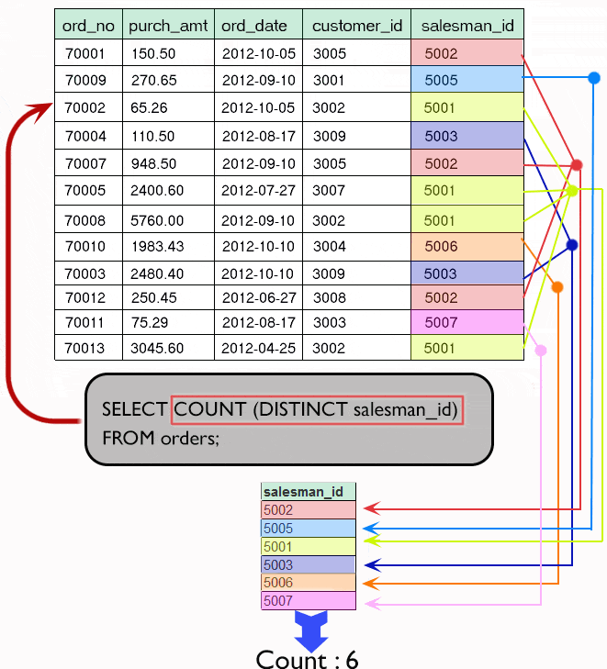
Query 18
Find the number of salesman currently listing for all of their customers.
orders(ord_no, purch_amt, ord_date, customer_id, salesman_id )
SELECT COUNT (salesman_id)
FROM orders;
SELECT COUNT (DISTINCT salesman_id)
FROM orders;

Slide 11
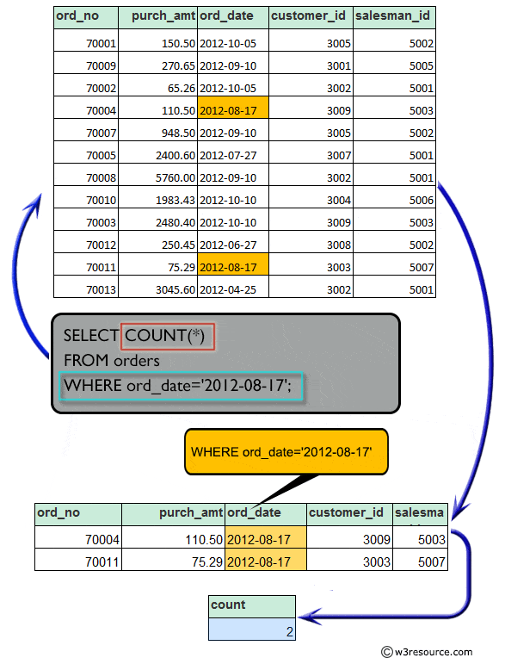
Query 19
Write a SQL statement that counts all orders for a date August 17th, 2012.
orders(ord_no, purch_amt, ord_date, customer_id, salesman_id )
SELECT COUNT(*)
FROM orders
WHERE ord_date = '2012-08-17';

Slide 12
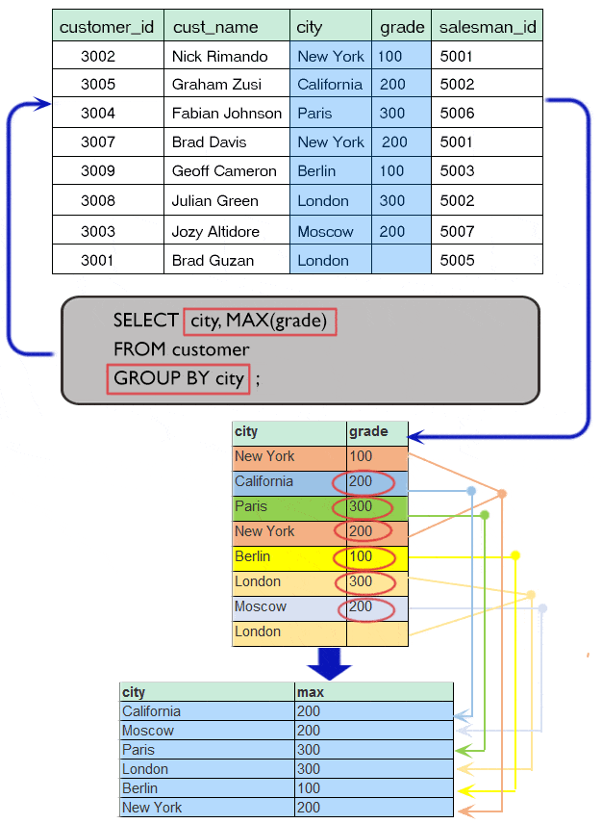
Query 20
Find the highest grade for each of the cities of the customers.
customer(customer_id, cust_name, city, grade, salesman_id)
SELECT city, MAX(grade)
FROM customer
GROUP BY city;

Slide 13
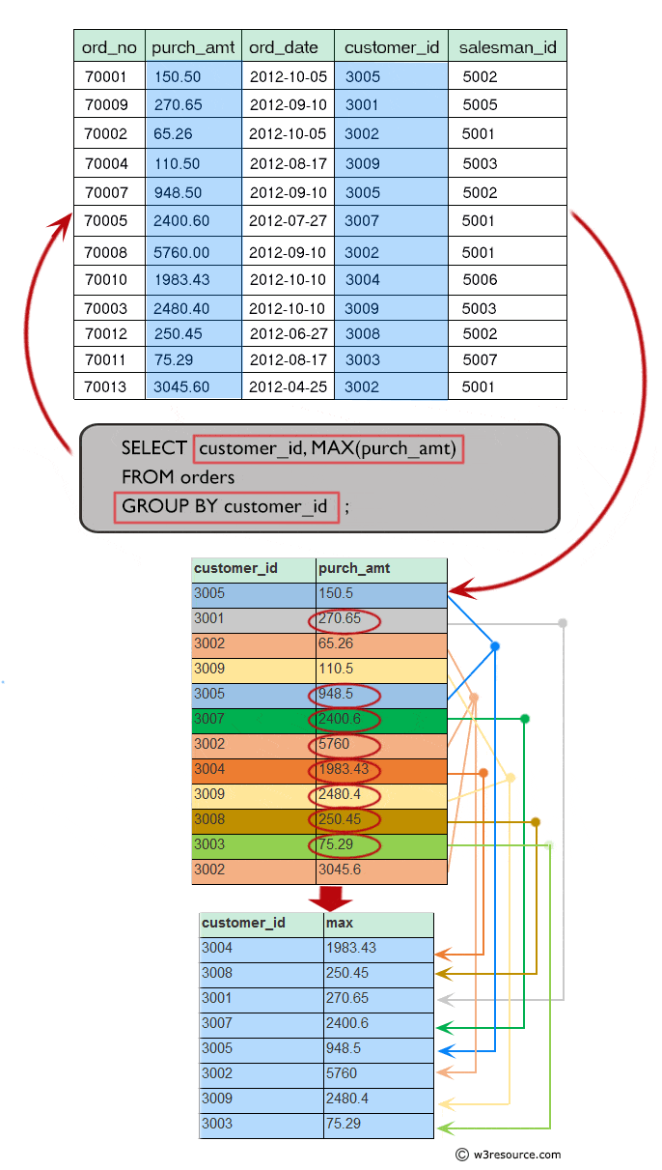
Query 21
Find the highest purchase amount ordered by each customer with their ID and highest purchase amount.
orders(ord_no, purch_amt, ord_date, customer_id, salesman_id )
SELECT customer_id, MAX(purch_amt)
FROM orders
GROUP BY customer_id;

Slide 14
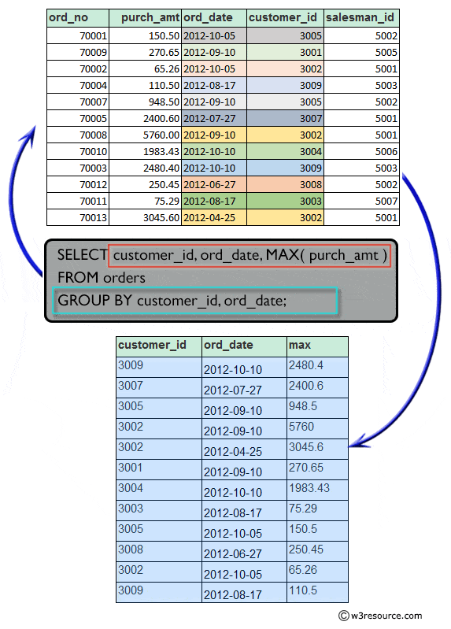
Query 22
Find the highest purchase amount ordered by each customer on a particular date with their ID, order date and highest purchase amount.
orders(ord_no, purch_amt, ord_date, customer_id, salesman_id )
SELECT customer_id, ord_date, MAX(purch_amt)
FROM orders
GROUP BY customer_id, ord_date;

Slide 15
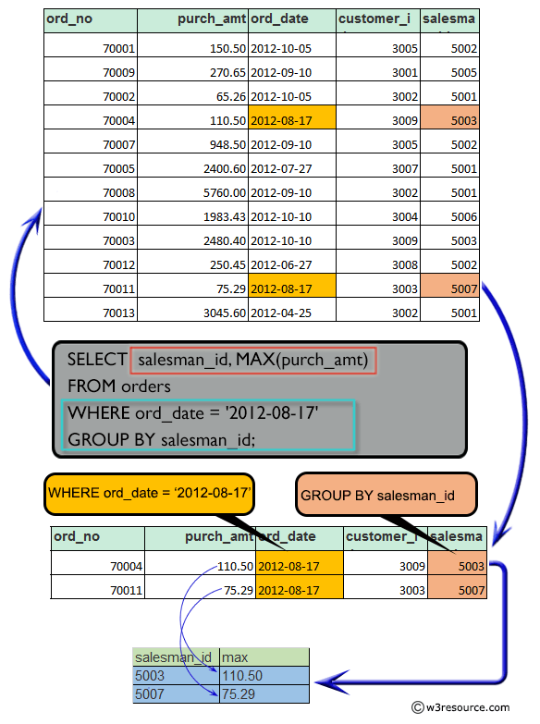
Query 23
Find the highest purchase amount on a date '2012-08-17' for each salesman with their ID.
orders(ord_no, purch_amt, ord_date, customer_id, salesman_id )
SELECT salesman_id, MAX(purch_amt)
FROM orders
WHERE ord_date = '2012-08-17'
GROUP BY salesman_id;

Slide 16
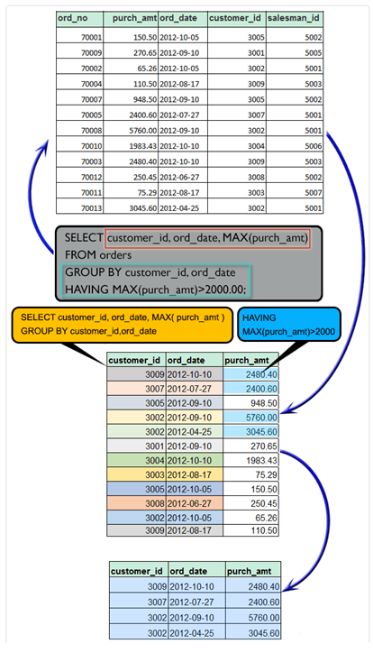
Query 24
Find the highest purchase amount with their customer ID and order date, for only those customers who have the highest purchase amount in a day is more than 2000.
orders(ord_no, purch_amt, ord_date, customer_id, salesman_id )
SELECT customer_id, ord_date, MAX(purch_amt)
FROM orders
GROUP BY customer_id, ord_date
HAVING MAX(purch_amt) > 2000.00;

